Slide 1
Policy advice
The problem
The solution
Decision analysis
First-best vs political choices
Time
Risk
Equity
Policy advice

Slide 2
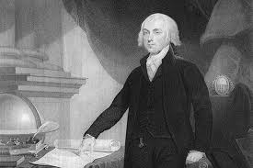
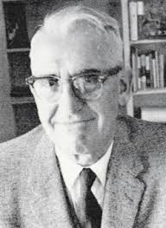
Models of democracy
Interest group pluralism (Madison)
Common interests are achieved by the give and take of the political process
Policy options come from the grassroots
The primary role for experts is to help special interests reduce the scope of policy choice in their preferred direction
Elite conflict (Schattscheider)
Common interests are identifiable independent of special interest demands on government
Policy options come from the experts
The primary role for experts is to expand or clarify the scope of political choice to open opportunities for political compromise

Slide 3
Models of science and policy
Linear model
Agree on facts
Take action
(Implicit: Science is objective)
(Implication: Scientism)
Stakeholder model
Feedback between research and policy
Policy shapes the questions asked by researchs
Research shapes the issues addressed by policy
(Implicit: Science is intersubjective)
(Implication: Social constructionism)

Slide 4
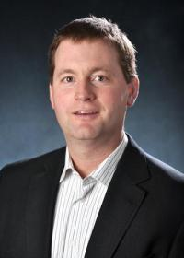
Models of policy advisors
 | Linear | Stakeholder
Interest group pluralism | Pure scientist | Issue advocate
Elite conflict | Science arbiter | Honest broker
Beware stealth advocates

Slide 5
The Three Big Questions
What if
Prediction
Positive
Natural and social science
So what
Assessment
Positive and normative
Social science
What to do
Advice
Positive and normative
Social science

Slide 6
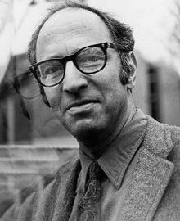


Post-Normal Science
Thomas Kuhn described normal science
Natural science
Jerry Ravetz and Silvio Funtowicz started post-normal science when
facts are uncertain,
values in dispute,
stakes high, and
decisions urgent.
They point out that the rules for quality control do not work for policy assessment and advice, but offer little practical guidance what to do instead

Slide 7
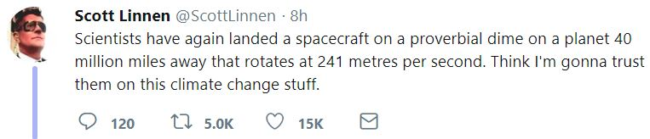
The role of science
Church offered a theory of how the world works, and how to behave
The Enlightenment separated “what if” from “what to do”
Science is now so vast and complex that we accept arguments based on authority in a discipline

Slide 8
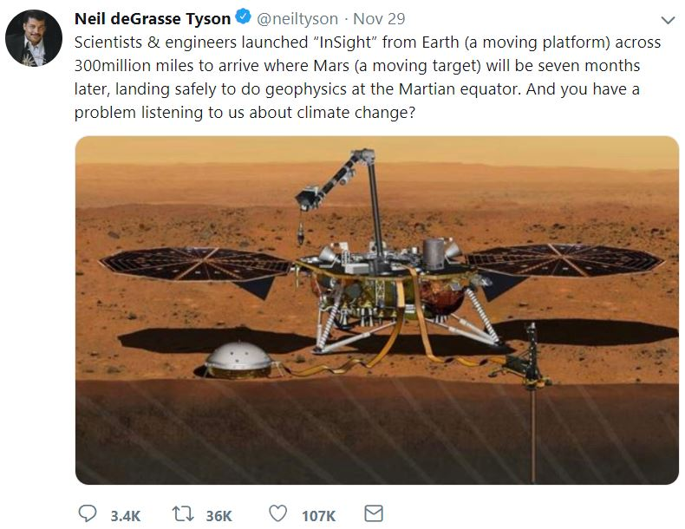

Slide 9
Players and incentives
Church offered a theory of how the world works, and how to behave
The Enlightenment separated “what if” from “what to do”
Science is now so vast and complex that we accept arguments based on authority in a discipline
Facts and morals derive from different authorities
Some find that confusing, and attach moral authority to science
Some academics enjoy that status
Some argue that because we‘re smarter, we‘re also better, wiser

Slide 10
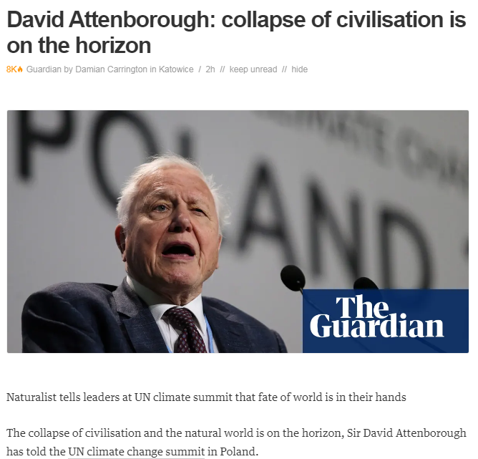

Slide 11


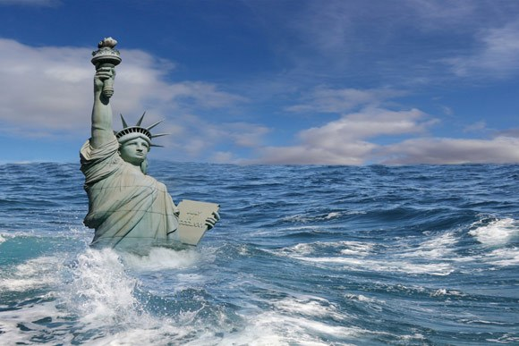
Players and incentives
Climate change is a discourse of fear: Emissions are sin, climate change a final reckoning
Environmentalists, like priests, offer redemption, moral superiority, a tribe to belong to
Tithes offer income and influence

Slide 12
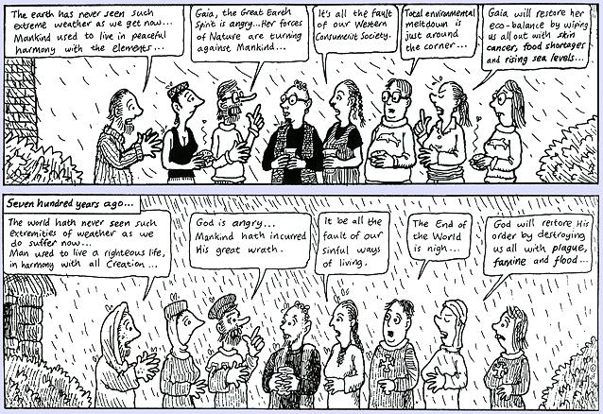

Slide 13
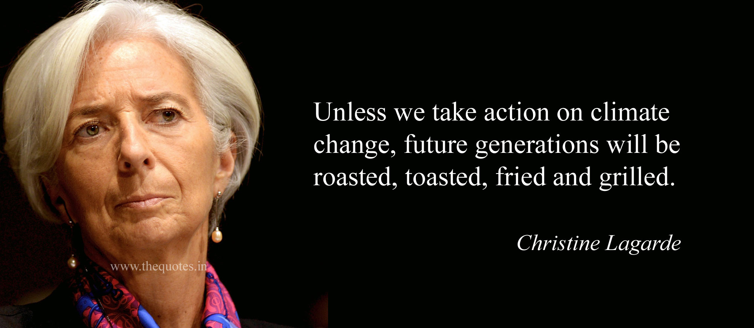
Players and incentives
Climate policy is a godsend for politicians
You can claim to want to save the world
You can blame Johnny Foreigner for inaction
You can give subsidies to those who voted for you
You can distort markets to create rents for you allies
You can deflect attention from your failings

Slide 14
Players and incentives
A carbon tax is an excise on energy and food. We already have such excises, so a small team in the Treasury is enough for climate policy
Instead, we have observed a rapid expansion of the number of civil servants working on a rapidly expanding climate bureaucracy

Slide 16
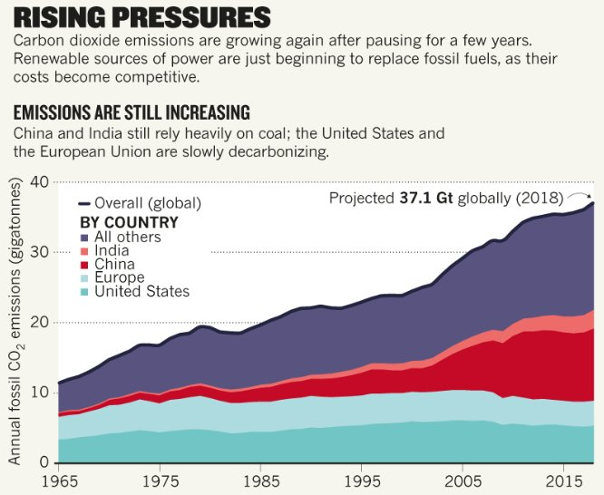

Slide 17

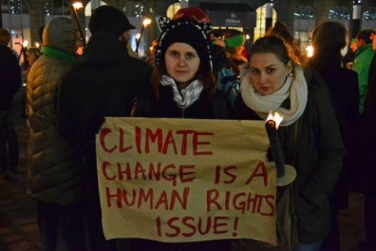

Players and incentives
Climate change is a band-wagon for other good causes

Slide 18
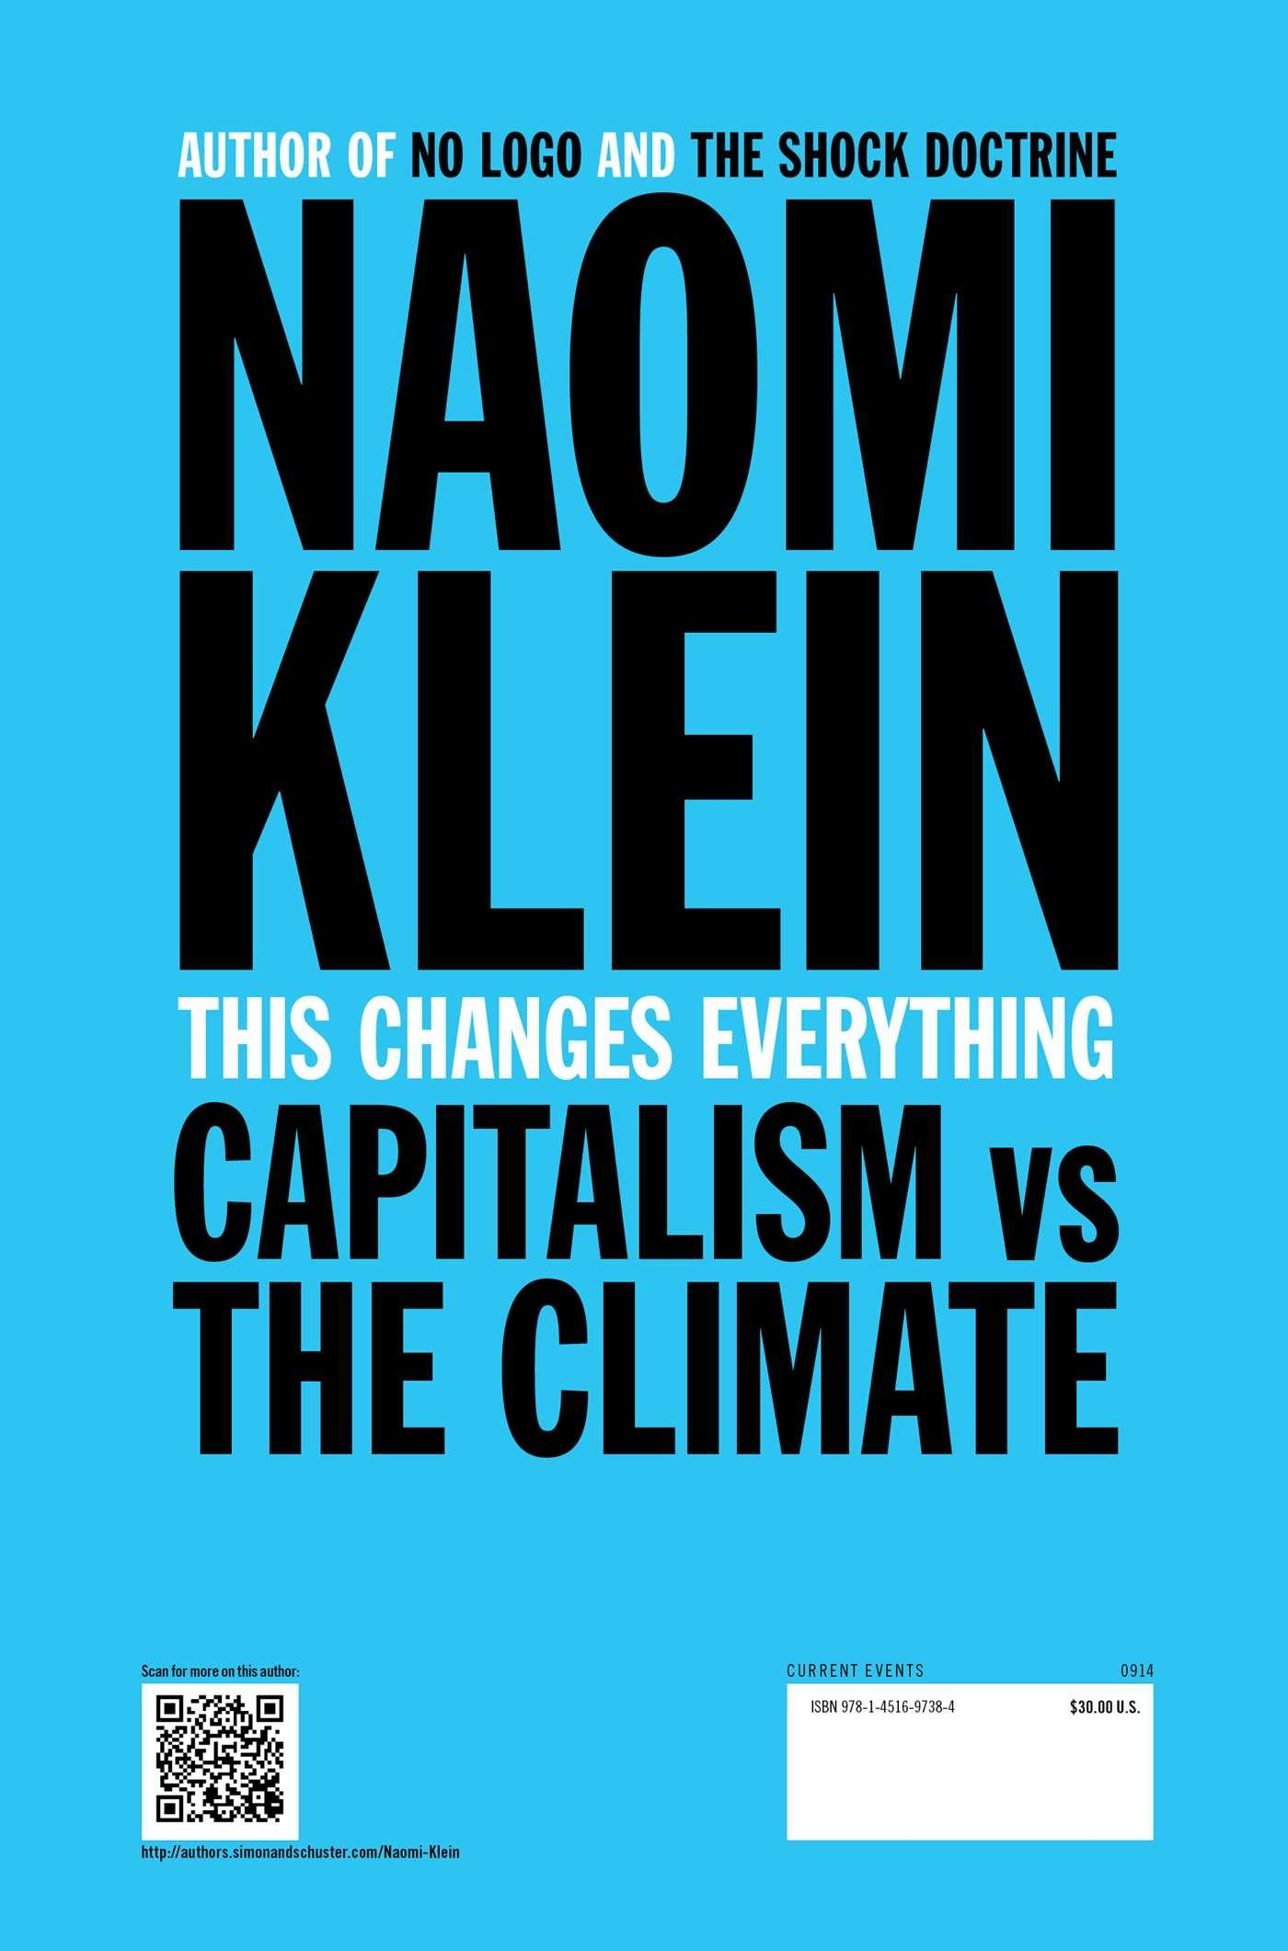
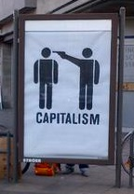
“We are remaking the world economy” – Christiane Figueres
“Climate policy is redistributing the world’s wealth” – Ottmar Edenhofer
“fundamental reorientation and restructuring of national and international institutions” – Frank Biermann

Slide 19
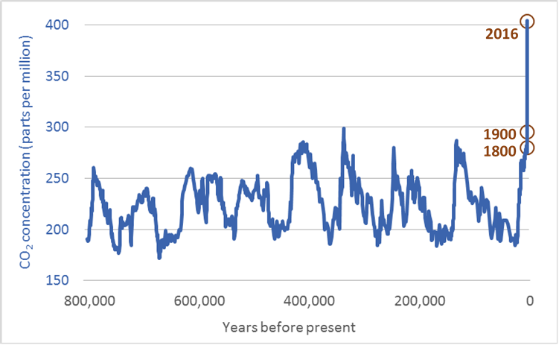

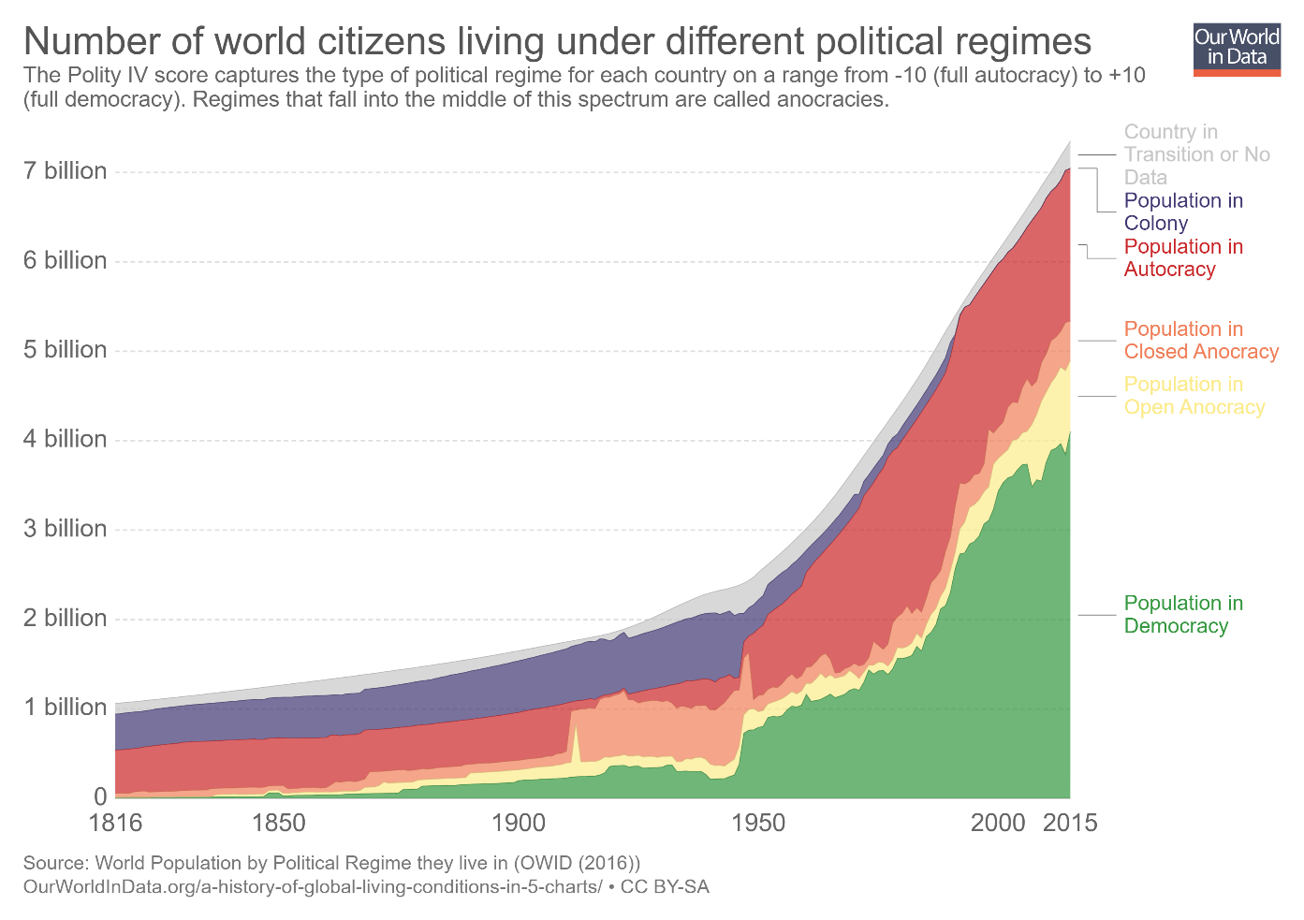
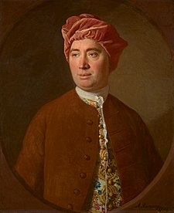
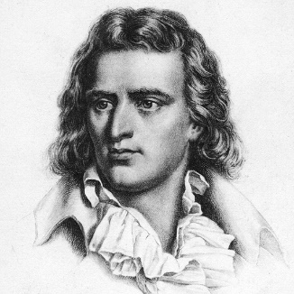
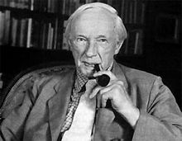
Fallacies
Climate change is often called unprecedented in a call for action
Is-ought, naturalistic fallacy

Slide 20
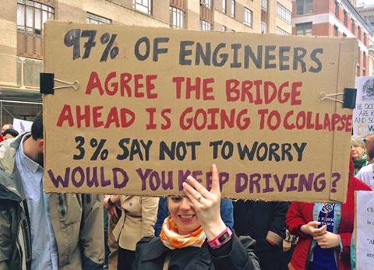
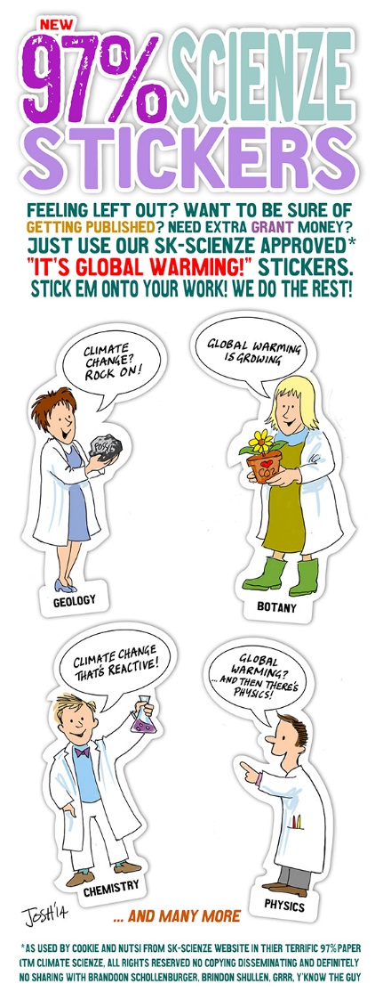
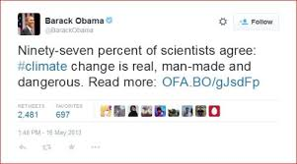
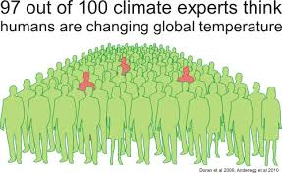
Fallacies
Climate change is often presented as a consensus

Slide 21
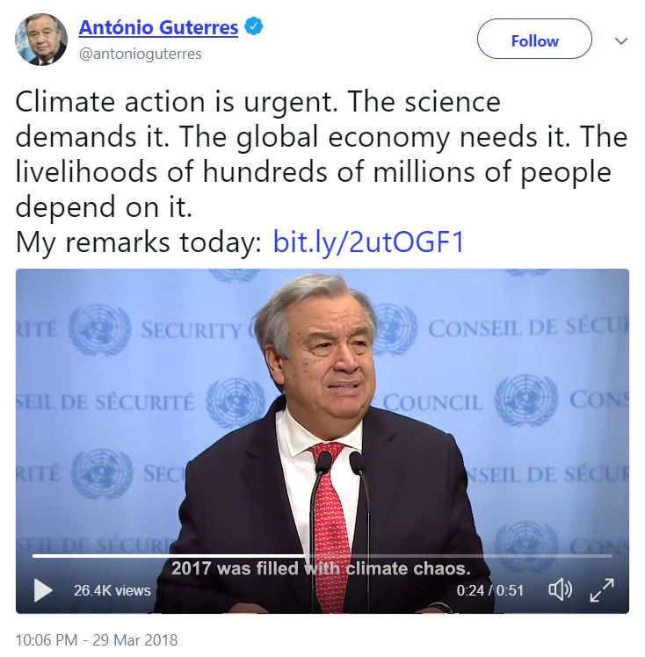
Fallacies
Climate policy is often phrased as a scientific imperative

Slide 22
Players and incentives
Climate policy is often phrased as a scientific imperative
This is a categorical error
You can’t explain that in a tweet or soundbite
You can claim that climate science is uncertain, unsettled, or a hoax
If you do not like taxes, or feminists, or development aid, or transfers of sovereignty, or trade barriers, or government regulation -- your best bet is to attack climate science
Climate science is far from perfect

Slide 23
What to do?
Policy advice mixes positive and normative elements
Bias and fallibility

Slide 24
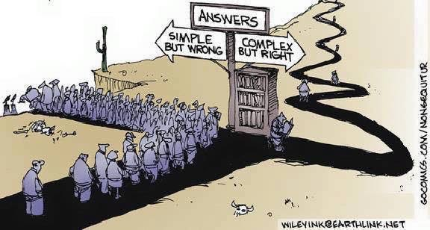
What to do?
Policy advice mixes positive and normative elements
Bias and fallibility
Panels are better than individuals
Embrace mavericks (but not charlatans)
Show sensitivity of results to assumptions

